Slide 1
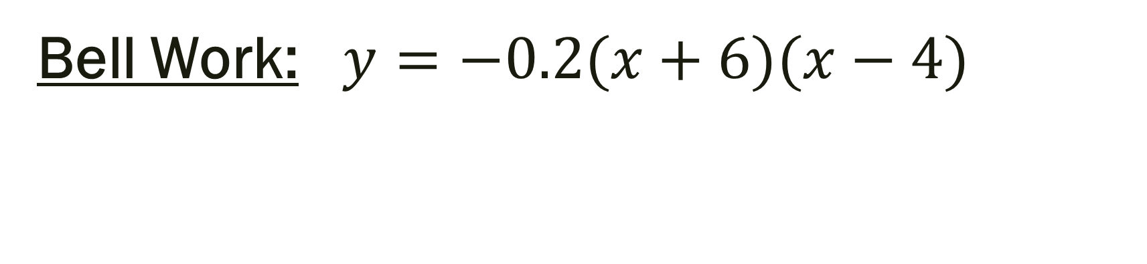
Bell Work: $y=−0.2(x+6)(x−4)$
Graph →
Vertex:
Max or Min?
Axis of Symmetry:
Domain:
Range:
Roots:
y-intercepts:
Transformations:

Slide 2
From Last Time
New Material:
Page 198 #4, 5, 15, 17
Page 206 #1-3, 9-11, 32, 38, 43, 57, 62, 63, 64

Slide 3
ALGEBRA 3
Day 34

Slide 4
4.3 Modeling With Quadratic Functions Objective: Solve quadratics in real life

Slide 5
Parabolas are a very common shape in the real world.
What are some things that are in the shape of a parabola?

Slide 6
What are some things that are in the shape of a parabola?
Bridges, Roller coasters,
Satellites, McDonalds, arch (kind of),
Three-point line, Fountain,
Rainbow, Flashlight,
Angry birds,
The path of an object when thrown…

Slide 7
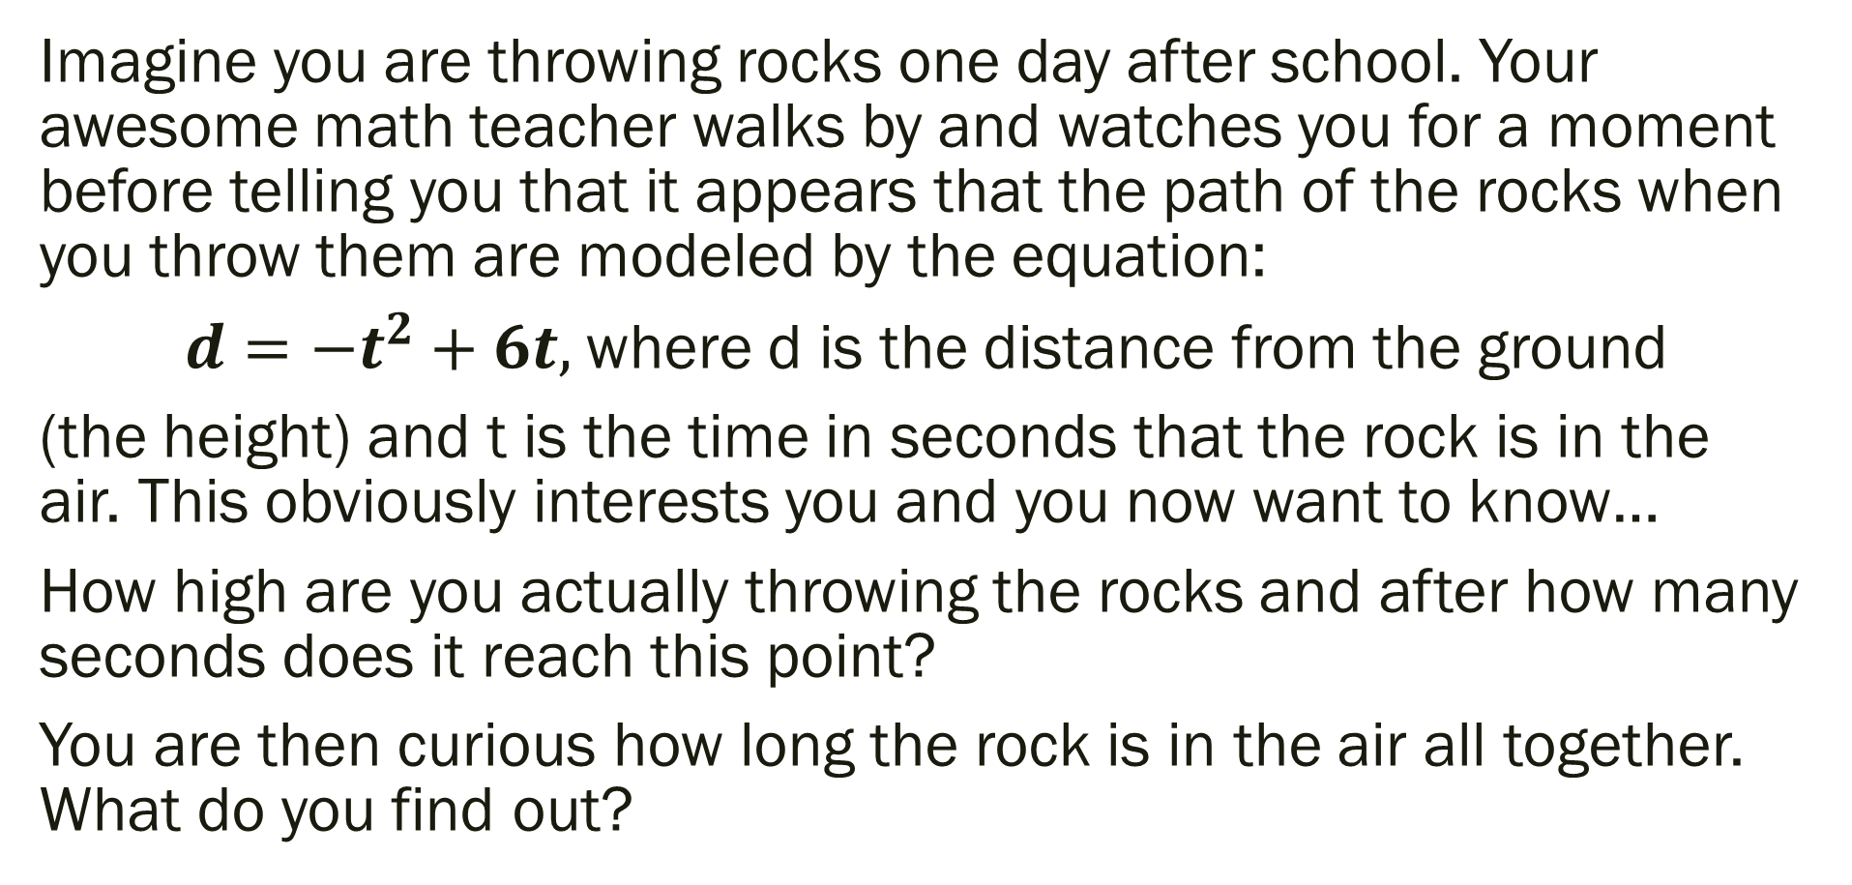
Examples:
Imagine you are throwing rocks one day after school. Your awesome math teacher walks by and watches you for a moment before telling you that it appears that the path of the rocks when you throw them are modeled by the equation:
$d={−t}^{2}+6t,$where d is the distance from the ground
(the height) and t is the time in seconds that the rock is in the air. This obviously interests you and you now want to know…
How high are you actually throwing the rocks and after how many seconds does it reach this point?
You are then curious how long the rock is in the air all together. What do you find out?

Slide 8
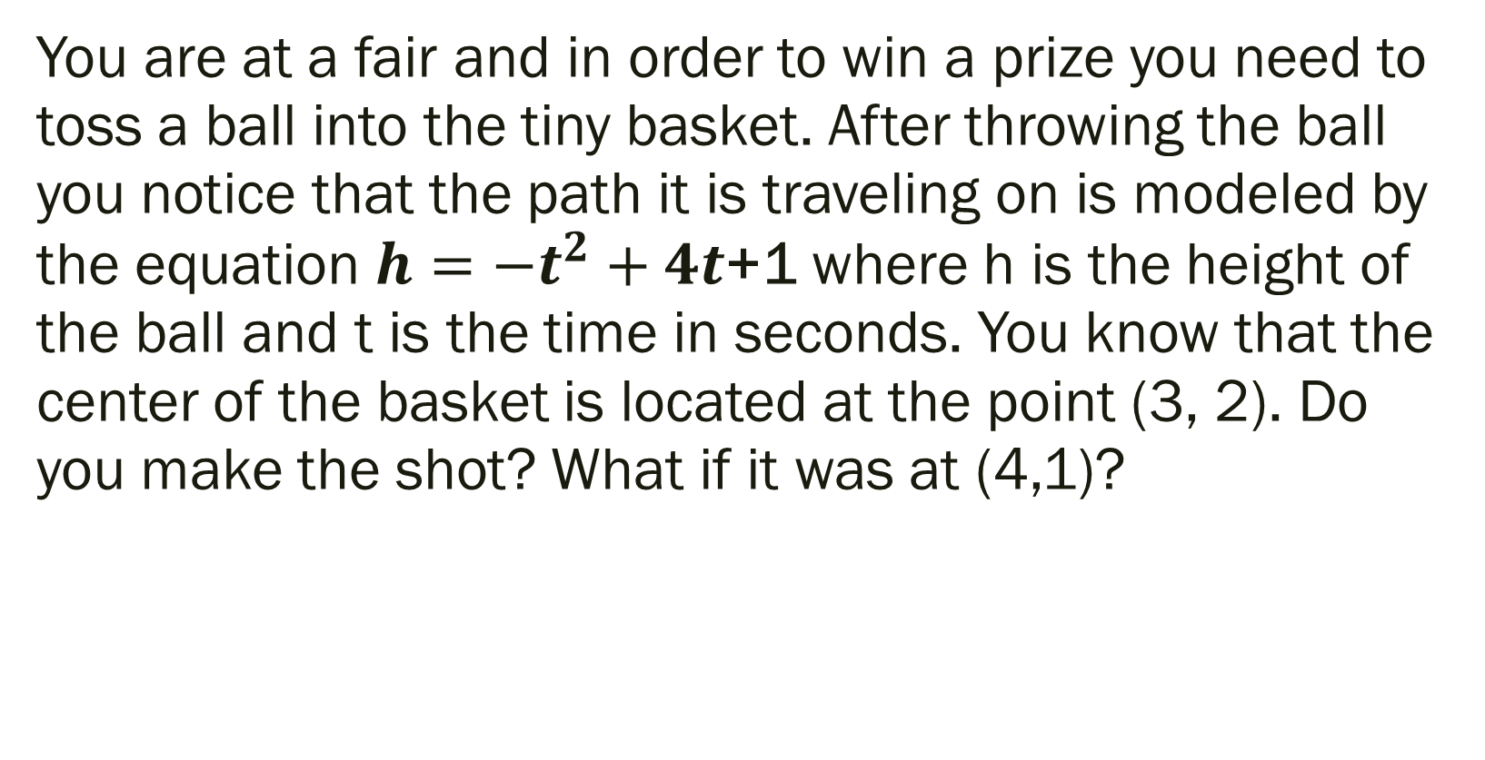
Example:
You are at a fair and in order to win a prize you need to toss a ball into the tiny basket. After throwing the ball you notice that the path it is traveling on is modeled by the equation $h={−t}^{2}+4t$+1 where h is the height of the ball and t is the time in seconds. You know that the center of the basket is located at the point (3, 2). Do you make the shot? What if it was at (4,1)?

Slide 9
For Next Time
New Material:
Page 212 #16, 28, 30
Mixed Review:
Page 212 #37, 41, 43

Slide 10
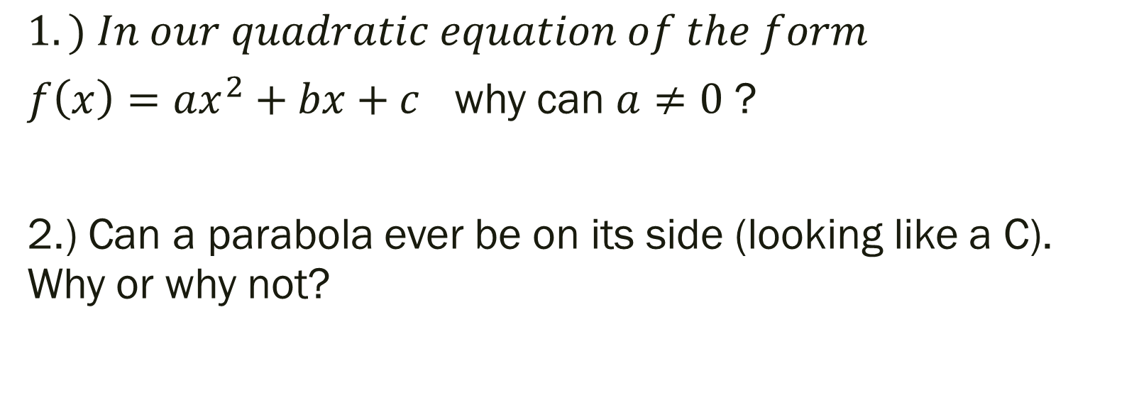
Unit 4 Quiz 1 Level 2
$$1.) In our quadratic equation of the form$$
$f\left(x\right)=ax^{2}+bx+c$ why can $a≠0$ ?
2.) Can a parabola ever be on its side (looking like a C). Why or why not?

Slide 11
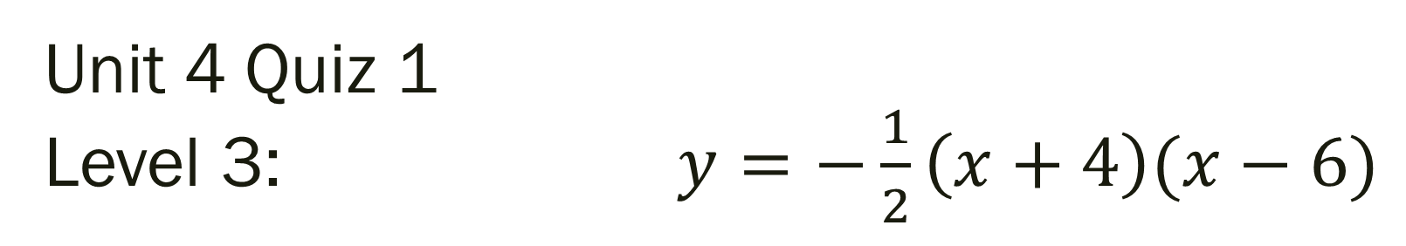
Unit 4 Quiz 1 Level 3: $y=−\frac{1}{2}\left(x+4\right)(x−6)$
Sketch a Graph
Vertex: Max or Min?
Axis of Symmetry:
Domain: Range:
Roots: y-intercepts:

Slide 12
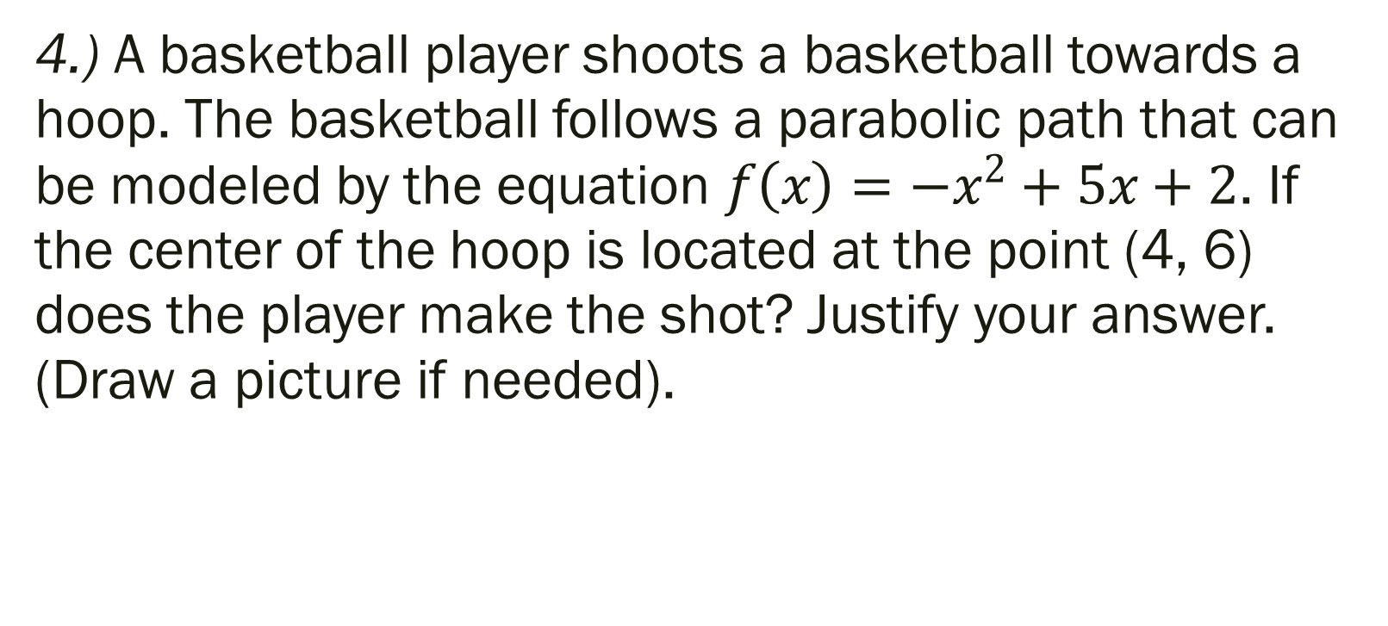
Unit 4 Quiz 1 Level 4:
4.) A basketball player shoots a basketball towards a hoop. The basketball follows a parabolic path that can be modeled by the equation $f\left(x\right)={−x}^{2}+5x+2$. If the center of the hoop is located at the point (4, 6) does the player make the shot? Justify your answer. (Draw a picture if needed).

